Slide 1
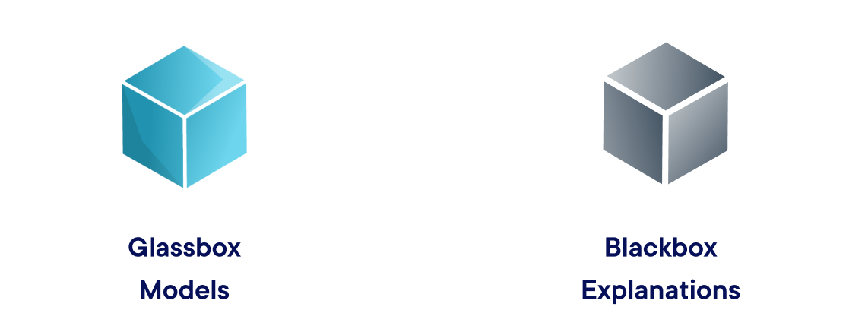
Interpretability Approaches

Slide 2

Models designed to be interpretable. Lossless explainability.
Explainable Boosting Machine
Decision Trees
Rule Lists
Linear Models
….
Fever?
Internal Bleeding?
Stay Home
Go to Hospital
Stay Home
Notes:
Update decision tree

Slide 3
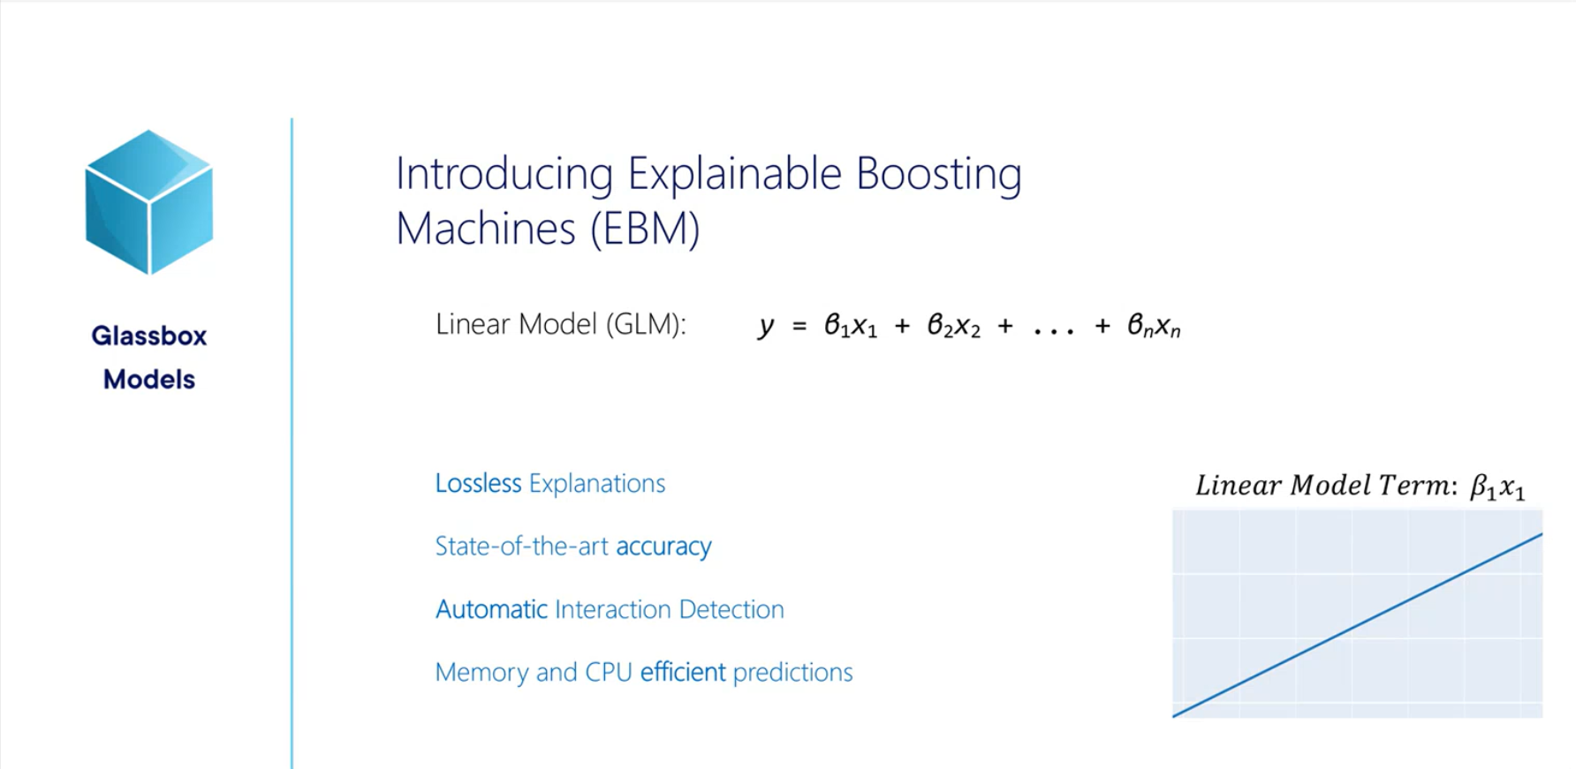

Slide 4
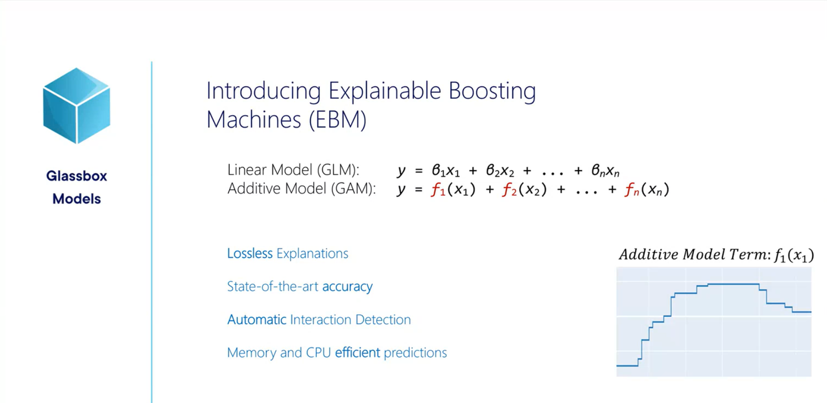

Slide 5
